Slide 1
MIDI Standard
Gabriel Rovesti - 2103389
July 3rd, 2024
Mobile Programming and Multimedia
2023-2024

Slide 2
Overview
MIDI: definition and representation
Types of information
Channels, tracks, patches
Types of messages and modes
Devices and connections
Conclusions

Slide 3

MIDI: what is it?
Communication protocol allowing electronic instruments to connect/exchange real-time data
Represents musical scores using a specific scripting language
Efficient compression, ideal for web and background music
Coding not completely standard and requires specific equipment
Used only for western music encoding

Slide 4
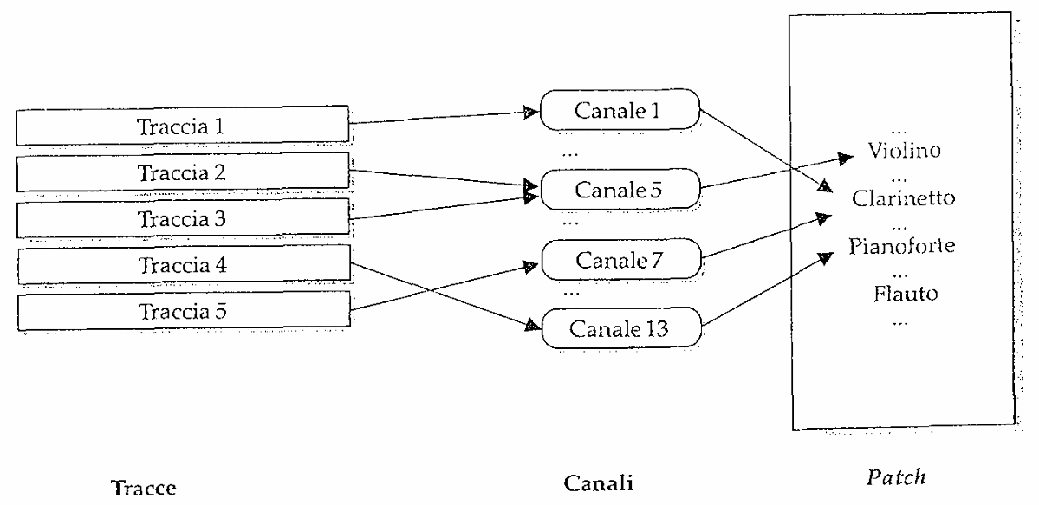
Types of information
Channels
Means through which send music events
Tracks
(Container of) Sequences of MIDI messages
Each track is associated to one or more channels
Patches
Pitch produced by a generator
Each channel is associated to one patch
Source: Audio e Multimedia – Valle/Lombardo

Slide 5
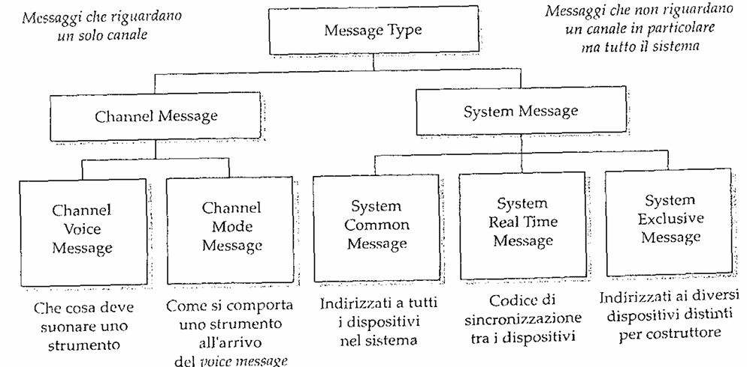
Types of messages
Source: Audio e Multimedia – Valle/Lombardo

Slide 6
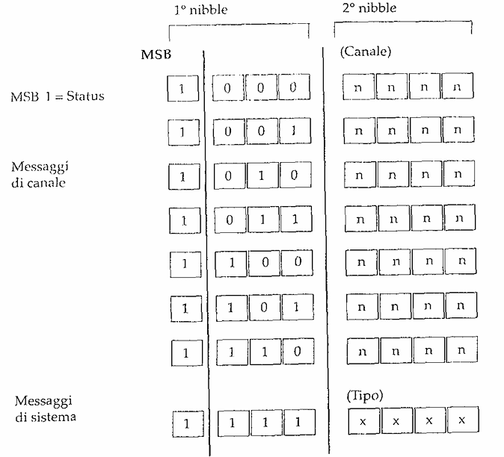
Structure of messages
Source: Audio e Multimedia – Valle/Lombardo

Slide 7
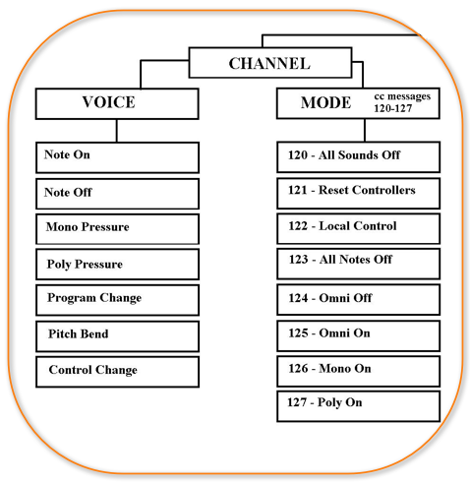
Channel messages
Voice messages
Musical events to be played by an instrument
There are different types
Note On / Note Off
Channel / Polyphonic Key Pressure
Pitch Bend / Program / Control Change
Mode messages
How an instrument behaves when voices messages arrive
There are different types
Omni On / Omni Off
Mono / Poly
Source: Wikiaudio

Slide 8
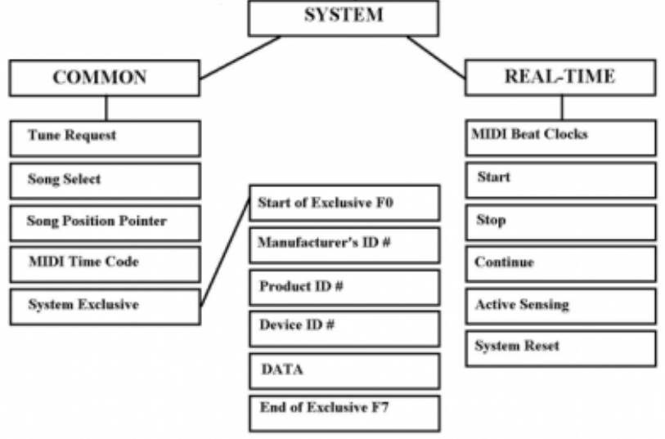
System messages
Common messages
General system functions across the system
There are different types
Song Select / Song Position Pointer
Tune Request
Real-time messages
Synchronization of different system modules
There are different types
MIDI Clock
System Reset
Start/Continue/Stop
Exclusive messages
Non-standard messages for specific manufacturers
Source: Wikiaudio

Slide 9
General MIDI Mode
ABC it’s easy

Slide 10
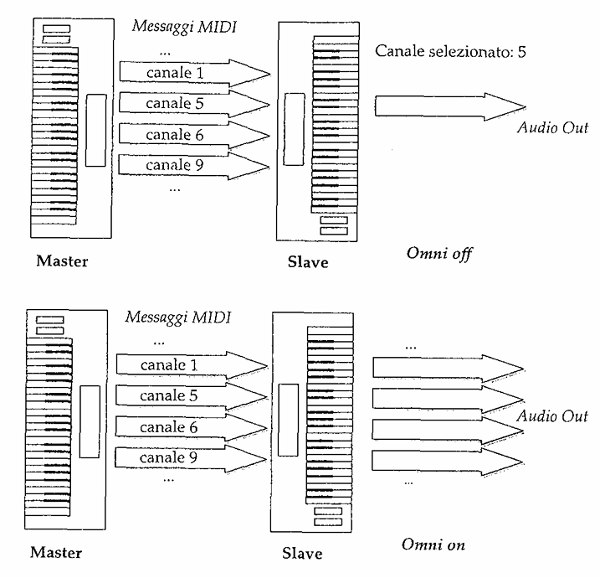
Modes

Slide 11
Devices and connections
aaa

Slide 12
Conclusions
aaa

